Slide 1
Azure virtual desktop with FSLOGIx
Project by Krystian Hoftun

Slide 2
Table of contents
The presentation is a form of slideshow for documentation going over:
Creating a VM and Installing & Configuring ADDS & AD Connect
Installing Active Directory Domain Services (ADDS) and AD Connect
Creating Users and Security Groups
Creating a File Share and Joining the Domain Controller
Creating a Virtual Machine for AVD
Setting Permissions
Installing and Configuring FSLogix

Slide 3
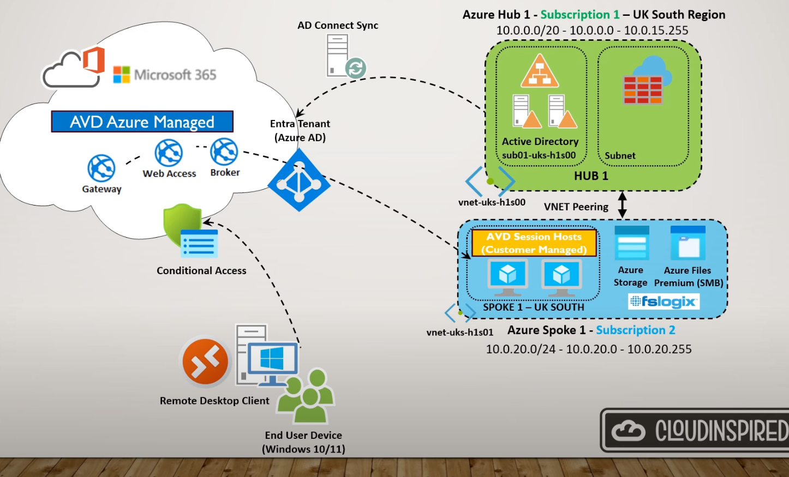
Topologi

Slide 4
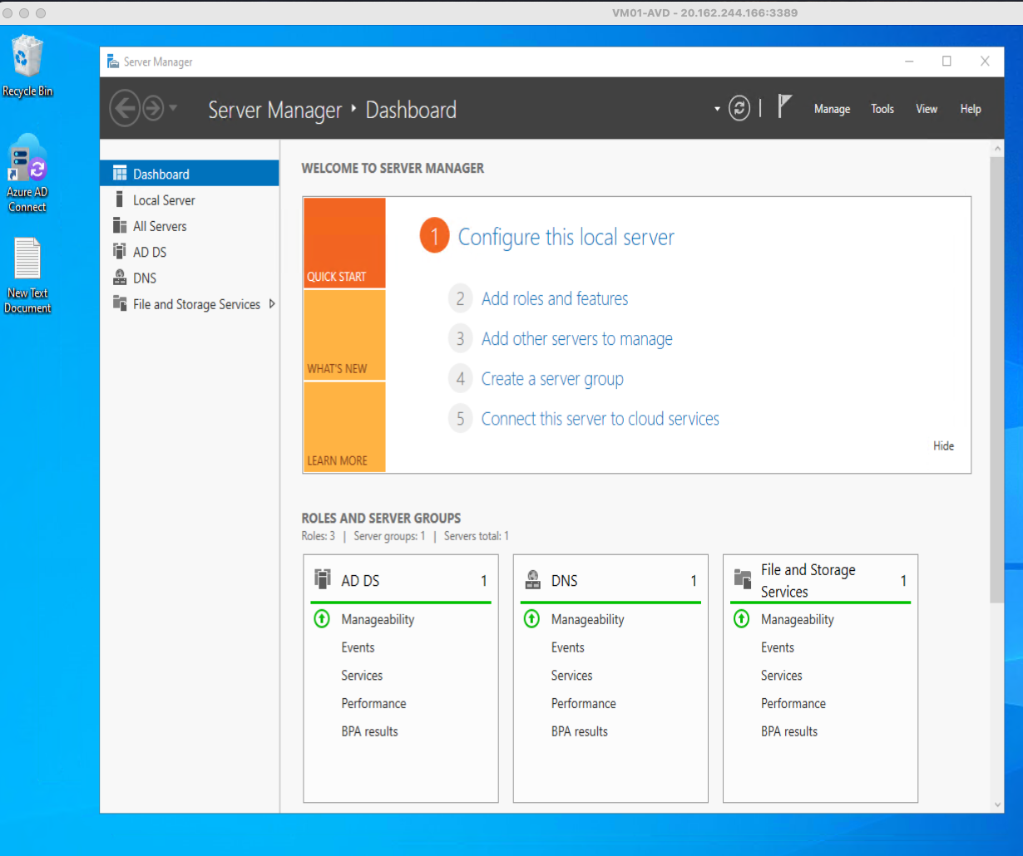
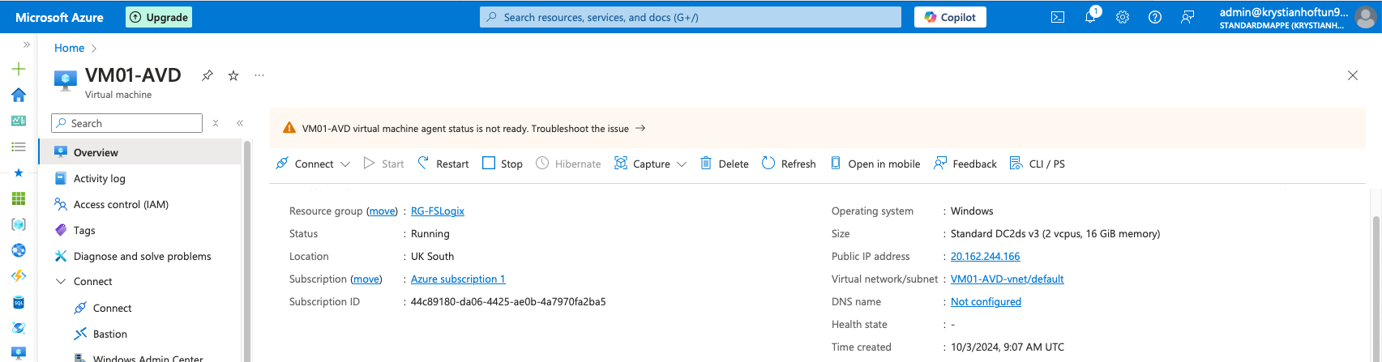
Creating a VM and Installing & Configuring ADDS & AD Connect
Set up a Virtual Machine (VM) and install ADDS and AD Connect to join Azure Entra ID for directory synchronization and authentication.

Slide 5
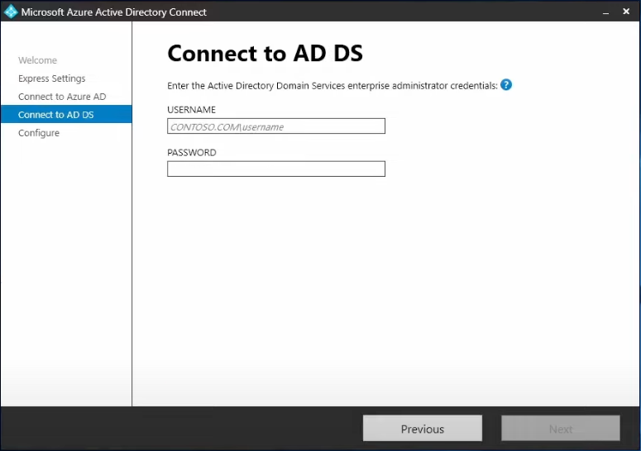
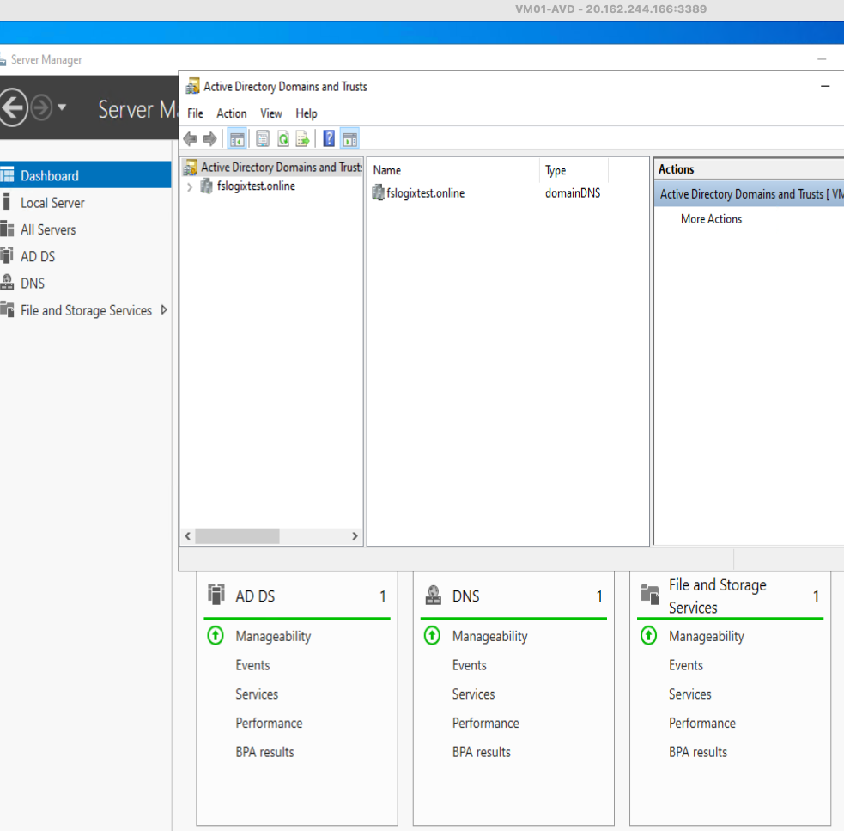
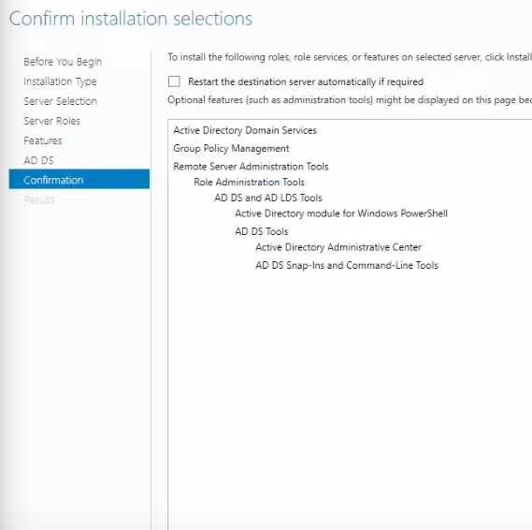
Installing Active Directory Domain Services (ADDS) and AD Connect
Setting up ADDS and AD Connect to sync your on-premises directory with Azure AD.

Slide 6
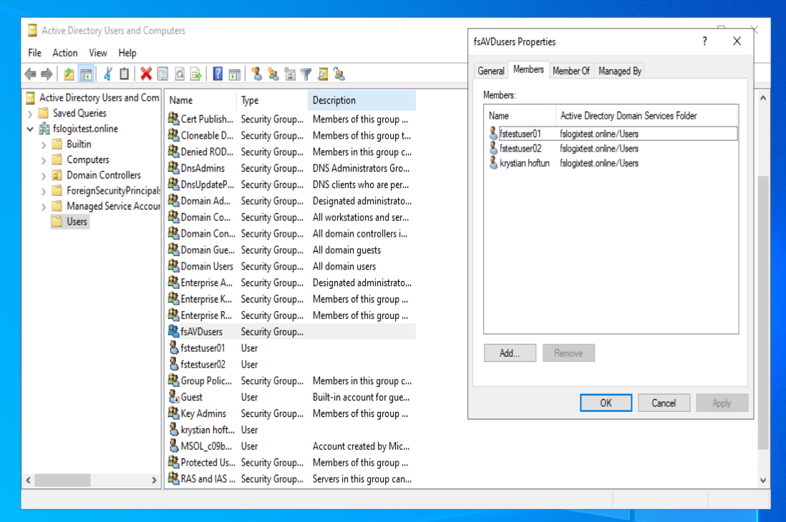
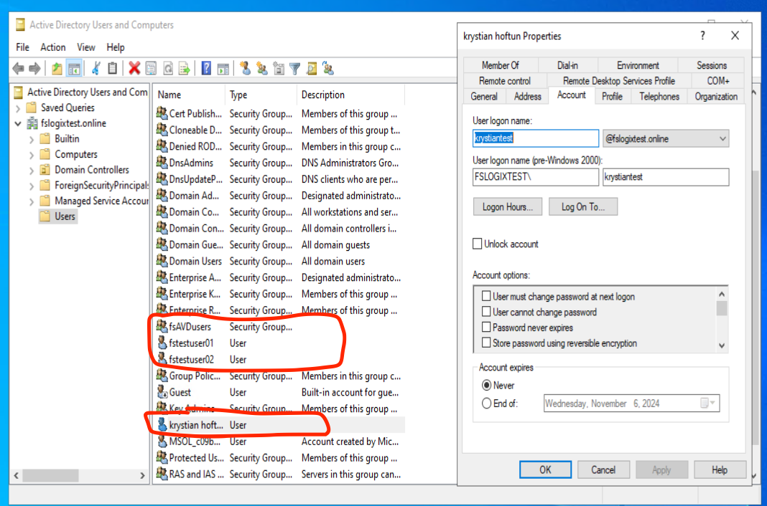
Creating Users and Security Groups
Create necessary Active Directory users and security groups that will be used for file share access and AVD deployment.

Slide 7
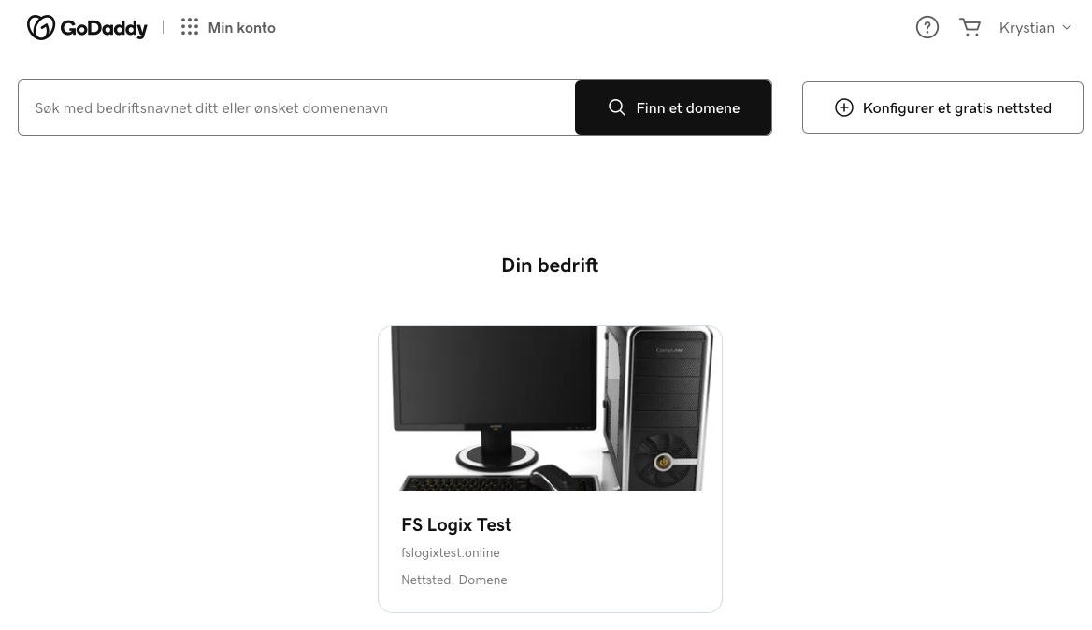
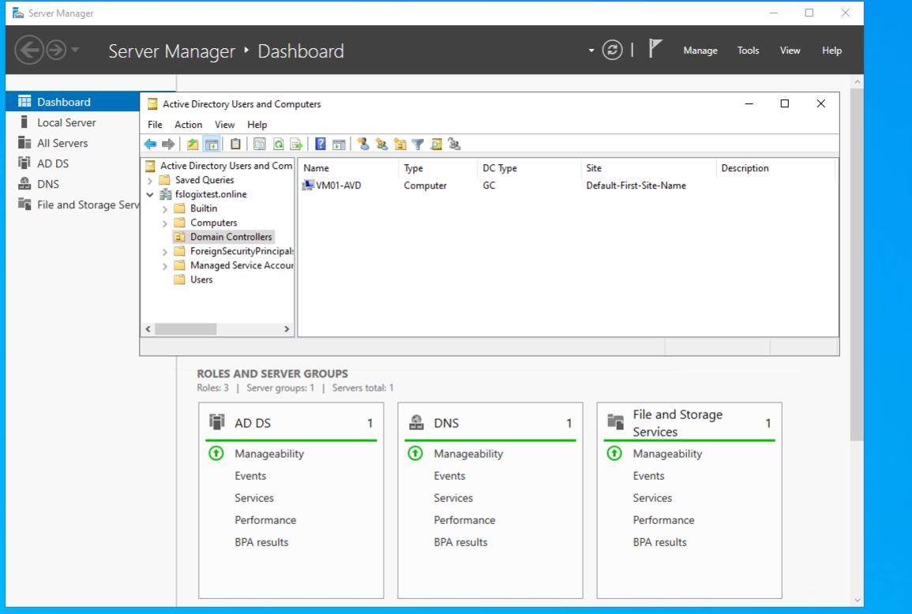
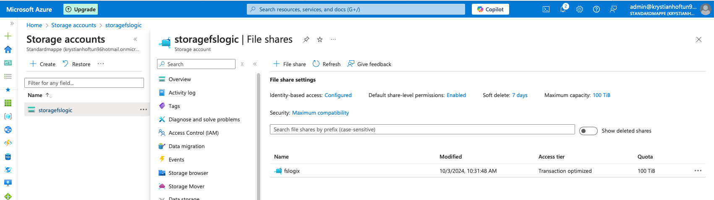
Creating a File Share and Joining the Domain Controller
Set up a file share in Azure storage and ensure it is joined to the domain to support FSLogix profile storage.

Slide 8
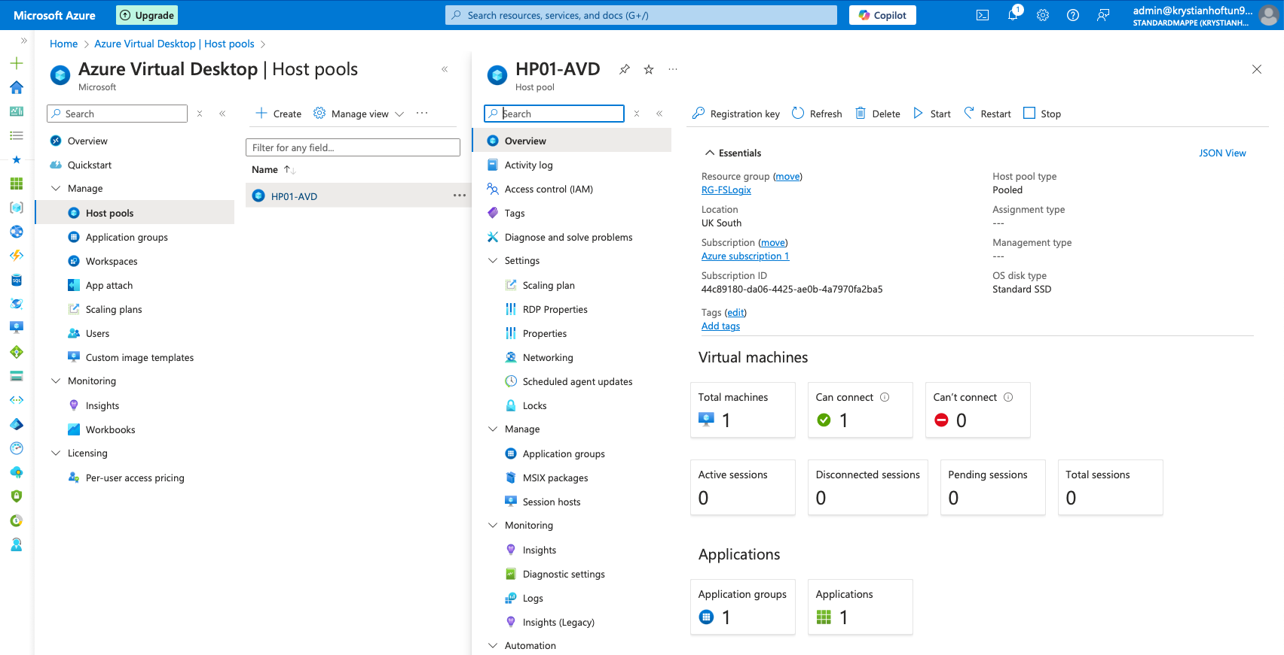
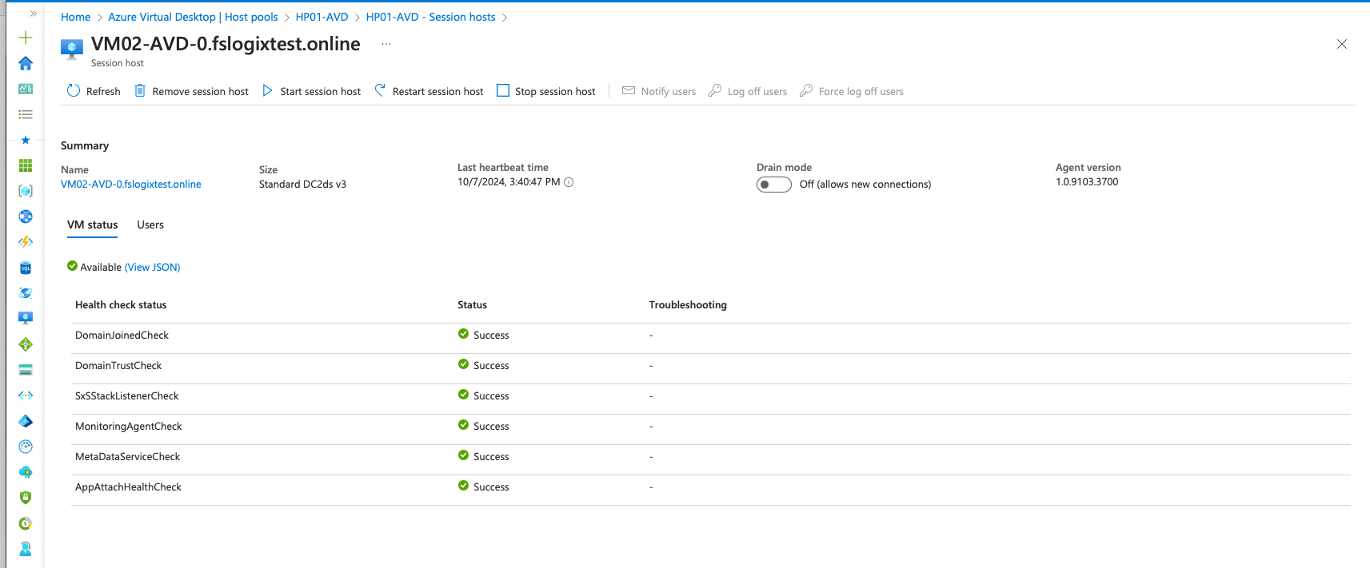
Creating a Virtual Machine for AVD

Slide 9
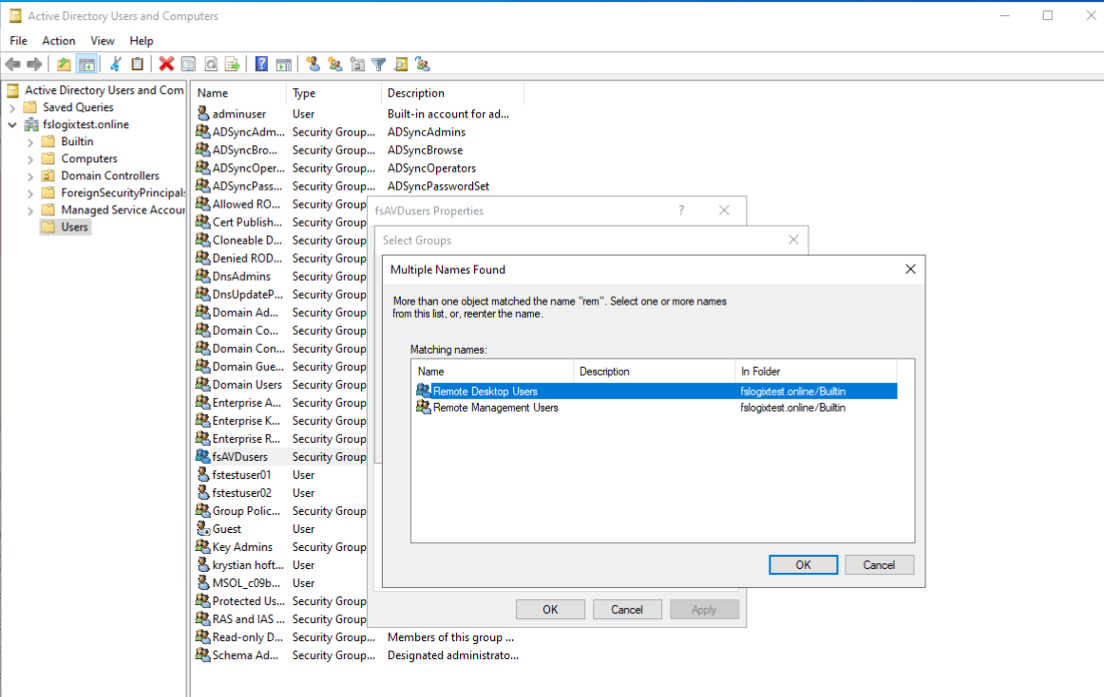
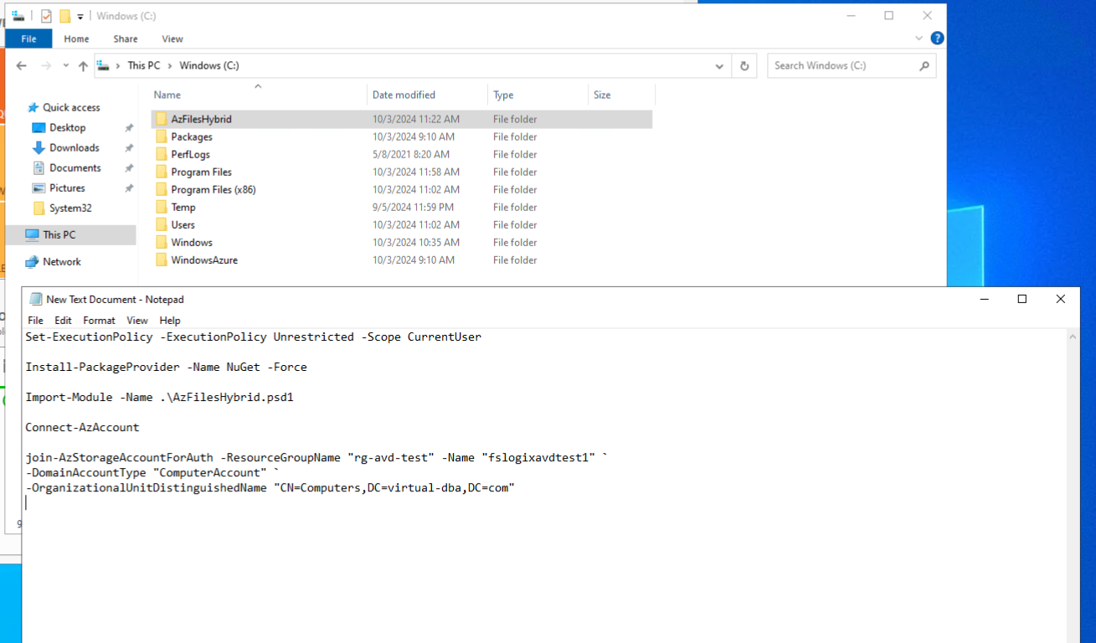
Setting Permissions
Set the required NTFS and file share permissions to allow users to access their profiles on the file share

Slide 10
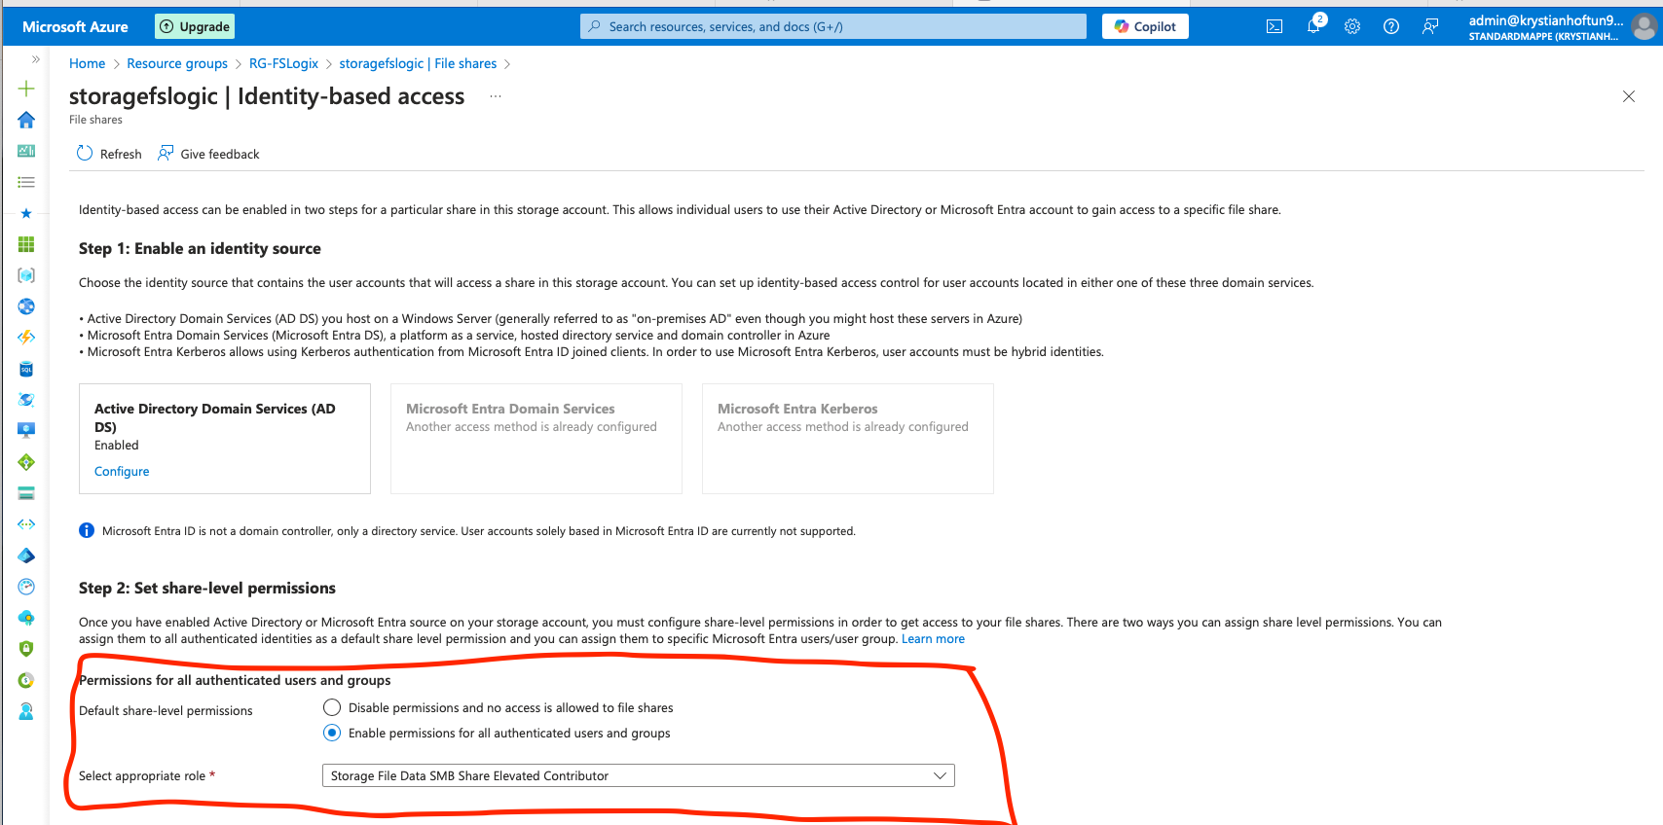
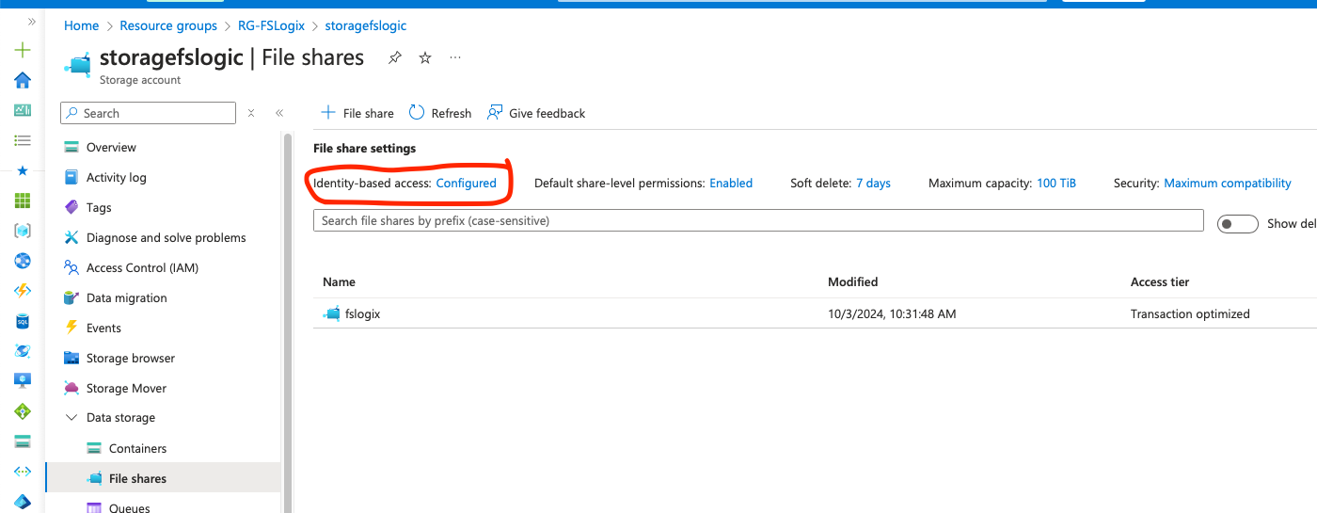
Setting Permissions
Set the required NTFS and file share permissions to allow users to access their profiles on the file share

Slide 11
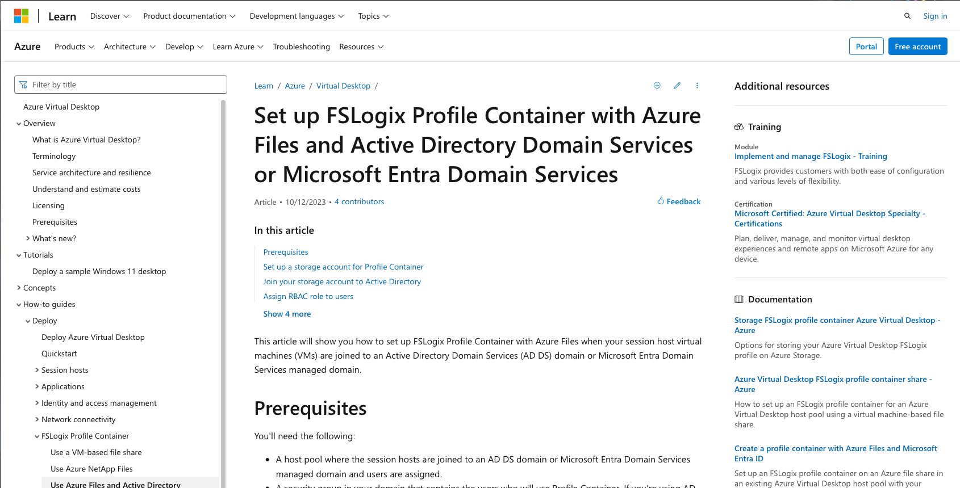
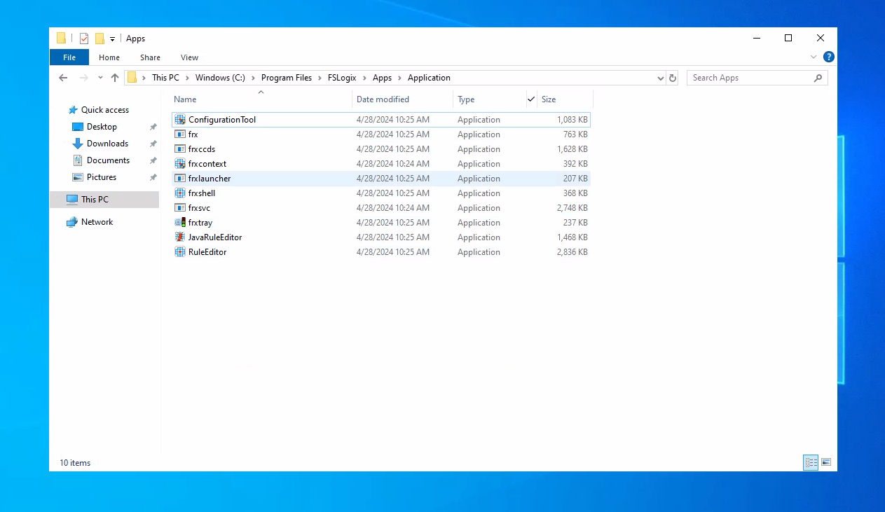
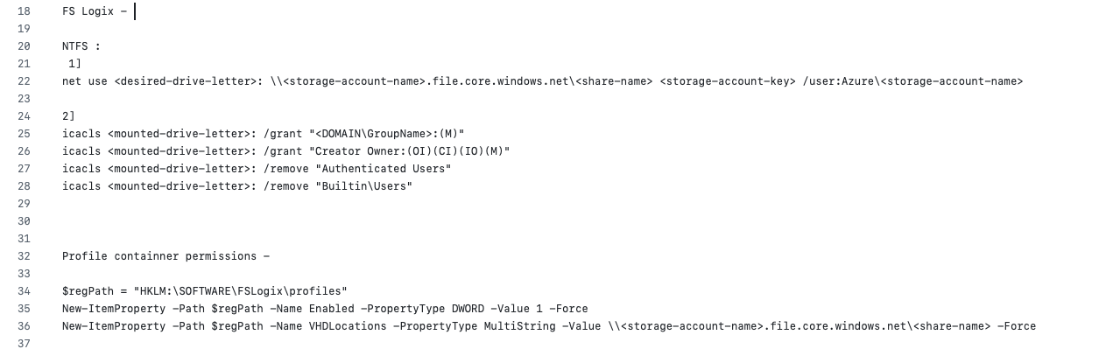
Installing and Configuring FSLogix
Install FSLogix and configure it to use Profile Containers for seamless profile management across AVD sessions.

Slide 12
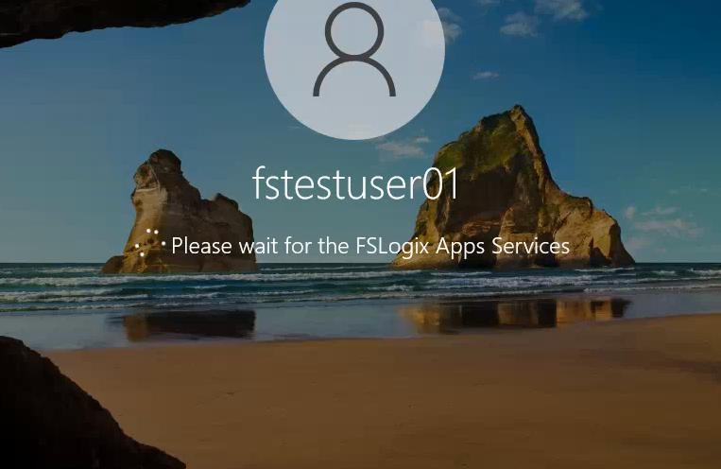
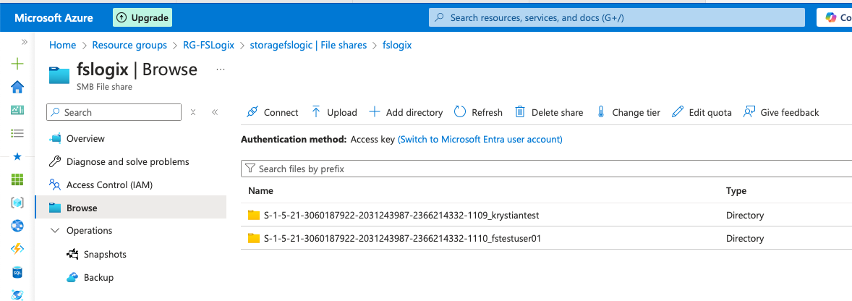
Result

